Slide 1







AI Securing the Future
Sean Wong
2025/08/05

Slide 2


01
02
03
AI Security Landscape
Physical AI Sentries
Cyber AI Shields
CONTENTS
04
05
Efficiency Boosters
Real-World Wins

Slide 3



CONTENTS
01
02
Adoption Roadmap
Key Takeaway

Slide 4

01
AI Security Landscape

Slide 5

AI in Surveillance
AI-driven video surveillance systems can analyze live feeds in real time to detect unusual behavior, identify objects, and alert security personnel, enhancing traditional monitoring methods.
01
AI Already Guards Your Shift
AI in Cybersecurity
AI tools analyze network traffic to detect anomalies and unauthorized access attempts, providing faster and more accurate threat detection compared to traditional cybersecurity methods.
02
AI in Incident Management
AI can automatically generate incident reports, track trends, and provide real-time alerts to security teams, improving efficiency and reducing human error in security operations.
03

Slide 6


Human-AI Patrol Partnership
AI for Repetitive Tasks
AI for Ethical Judgments
AI handles repetitive tasks such as video analytics and log correlation, freeing human security personnel to focus on strategic decision-making and complex incident management.
Security professionals retain control over ethical judgments, de-escalation, and client relations, ensuring that AI augments rather than replaces human oversight and accountability.

Slide 7
02
Physical AI Sentries

Slide 8



Video Analytics Spot Anomalies
Real-Time Alerts
Geo-Located Alerts
AI-powered video analytics can send real-time alerts to security personnel when unusual behavior or potential threats are detected, reducing response times.
AI can push geo-located alerts to radios or mobile devices, ensuring that the nearest security personnel receive immediate notifications of potential threats.
Color-Coded Risk Levels
Reduced False Positives
AI systems can color-code risk levels in video feeds, making it easier for security teams to prioritize and respond to incidents quickly and effectively.
AI algorithms are designed to minimize false positives, providing more accurate and reliable threat detection compared to traditional surveillance methods.

Slide 9
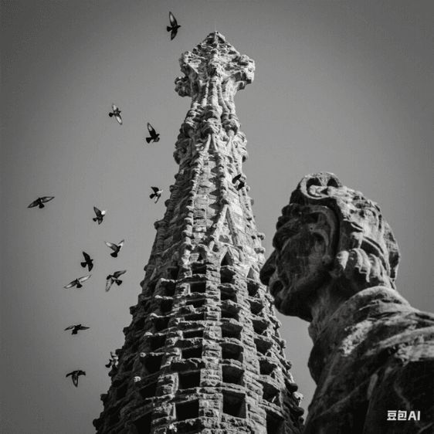

Facial Recognition Controls Access
Facial Recognition for Access Control
Facial recognition technology can unlock turnstiles and access points for authorized personnel while triggering alarms for unauthorized individuals, enhancing physical security.

Slide 10



Predictive Policing Maps Risks
Historical Data Analysis
Proactive Deployment
Real-Time Adjustments
AI models analyze historical incident data, weather patterns, and event calendars to forecast potential security threats and crime hotspots.
Security teams can proactively deploy resources to high-risk areas based on AI predictions, preventing incidents before they occur.
AI systems continuously update risk maps in real time, allowing security personnel to adjust their strategies dynamically as conditions change.

Slide 11

Drones Patrol Wide Perimeters
Autonomous Drones
Autonomous drones equipped with thermal cameras and object tracking can patrol large areas, providing continuous surveillance without human intervention.
Cost-Effective Security
Using drones for security patrols can be more cost-effective than traditional methods, reducing the need for extensive human patrols and lowering operational costs.

Slide 12
03
Cyber AI Shields

Slide 13

IDS Learns Network Baselines
01
02
03
Behavioral Baselines
Ransomware Prevention
Precise Alerts
AI-driven IDS systems learn normal network behavior to detect anomalies, such as unusual data patterns or unauthorized access attempts, providing early threat detection.
AI can automatically isolate compromised devices and block malicious traffic, preventing ransomware from spreading and reducing the impact of cyber attacks.
AI generates precise and actionable alerts, guiding security teams to respond effectively to threats without being overwhelmed by false positives.

Slide 14

Behavior Analytics Catch Insiders
01
User Behavior Monitoring
AI tracks user login times, file access, and badge swipes to detect unusual behavior that may indicate insider threats or account compromise.
02
Graded Alerts
AI systems provide graded alerts based on the severity of detected anomalies, helping security teams prioritize their response efforts.

Slide 15

SOAR Playbooks Auto-Respond
Automated Incident Response
SOAR platforms use AI to run automated playbooks that block IPs, quarantine infected devices, and open tickets, reducing mean-time-to-contain and improving incident management.

Slide 16
04
Efficiency Boosters

Slide 17

Smart Rosters Cut Labor Waste
01
AI-Driven Scheduling
AI aligns guard schedules with forecasted risk levels and historical incident data, ensuring optimal staffing levels and reducing overtime costs.
02
Mobile Shift Management
Mobile apps enable officers to swap shifts and manage schedules efficiently, improving workforce flexibility and job satisfaction.

Slide 18

Voice-to-Text Transcription
AI transcribes officer narratives and auto-populates incident reports, reducing the time spent on manual report writing.
Auto-Reports Replace Typing
Consistent Records
Reduced Admin Workload
AI ensures consistent and searchable incident records, facilitating faster insurance claims and more effective client reporting.
Automated reporting reduces the administrative burden on security teams, allowing them to focus on core security tasks.

Slide 19

Instant Alerts Speed Reactions
Real-Time Notifications
AI sends real-time alerts to security personnel, ensuring they receive critical information immediately and can respond faster to incidents.

Slide 20
05
Real-World Wins

Slide 21

Retail Chain Cuts Theft 25%
01
02
AI Cameras in Retail
Enhanced Evidence Collection
A national retail chain deployed AI cameras that match live faces against known shoplifter databases, resulting in a 25% reduction in thefts and improved security.
AI systems generate evidence packages, providing security teams with detailed incident reports that support more effective investigations.

Slide 22
HQ Blocks Unauthorized Entry
01
02
03
Facial Recognition Turnstiles
Pre-Registration and Screening
Audit Logs for Compliance
A corporate campus replaced key-cards with facial recognition turnstiles, enhancing access control and preventing unauthorized entry.
AI links visitor pre-registration with watch-list screening, ensuring that only authorized individuals can enter the premises.
AI generates audit logs that satisfy compliance requirements and reduce the need for after-hours guard overtime.

Slide 23
06
Adoption Roadmap

Slide 24
Map Pain Points First
Audit Current Operations
Rank ROI Potential
Welcome Officer Feedback
Conduct an audit of current security operations to identify high-frequency, low-judgment tasks that AI can automate, such as patrol verification or report writing.
Rank identified tasks based on their ROI potential, ensuring that AI investments target areas that will provide the most significant benefits.
Involve security officers in the planning process to ensure that AI solutions address their pain points and are welcomed rather than resisted.

Slide 25

Pick Scalable Secure Tools
01
Choose vendors offering on-premises options to ensure data security and compliance with privacy regulations.
On-Prem Options
02
Select AI tools that integrate seamlessly with existing security systems, such as radios, VMS, and guard-tour platforms, to maximize ROI.
API Integration

Slide 26

Train Teams & Monitor Results
Run Pilot Shifts
Run pilot shifts with super-users to measure response times, false-positive rates, and officer satisfaction before full-scale deployment.

Slide 27
07
Key Takeaway

Slide 28
AI Augments Officer Effectiveness
Extended Reach
Faster Reactions
Ethical Oversight
Judgment and Empathy
AI extends the reach of security officers by providing real-time alerts and automated incident management, enhancing their ability to respond to threats.
AI tools enable faster reaction times by providing instant notifications and actionable insights, improving overall security effectiveness.
Security professionals maintain ethical oversight and critical incident command, ensuring that AI augments rather than replaces human judgment.
Use AI to eliminate repetitive tasks, allowing security officers to focus on judgment and empathy, which are essential for professional security.

Slide 29
THANK YOU
Sean Wong
2025/08/05

